Slide 1
RG-650: OpenCV Advanced Instructor: Omar Silva

Slide 2
Table of Contents
HaarCascades: Vehicles, Stop Signs, Traffic Lights
Traffic Light Detection (Colour/Contours)
Creating HaarCascades
QR Code Recognition (Swarm)
OCR Recognition
Simple Lane Detection
Advanced Lane Detection
GP Self Driving Car

Slide 3
RG-650: OpenCV Advanced Chapter 1: HaarCascades: Vehicles, Stop Signs, Traffic Lights

Slide 4
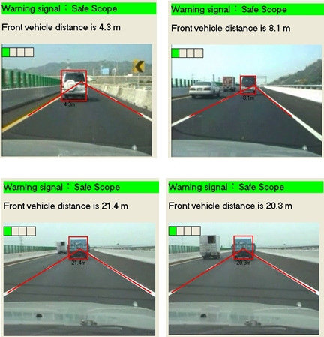
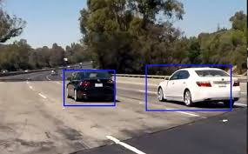
1.1 Vehicle Detection
Vehicle detection
Distance estimation

Slide 5
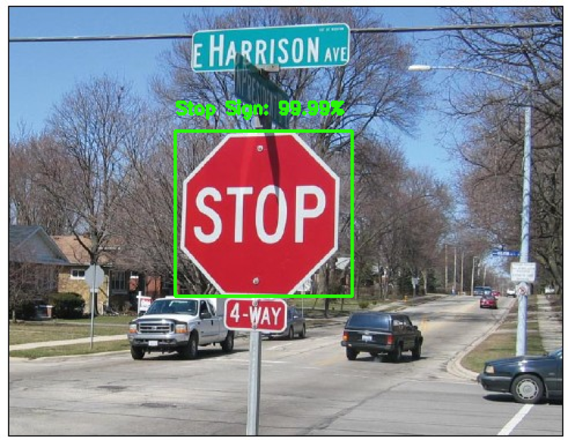
1.2 Stop Sign Detection
Other Methods that can be used include:
-Template matching
-HOG
-CNN

Slide 6
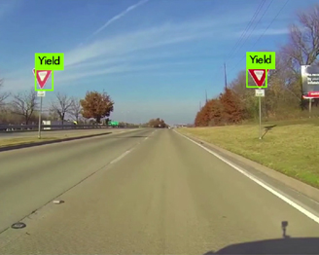

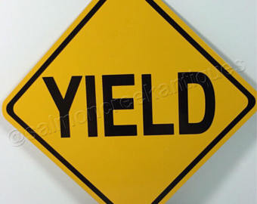
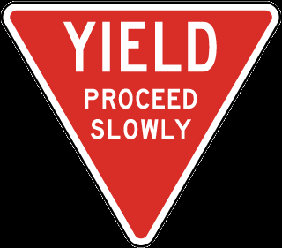
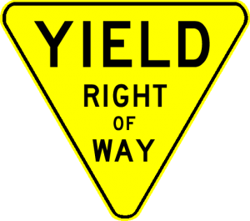
1.3 Yield Sign Detection
Challenge: Lack of standardization. Training requires great amount of data

Slide 7
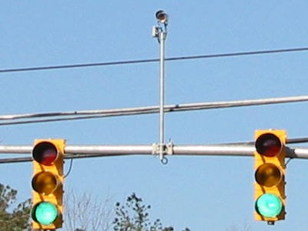
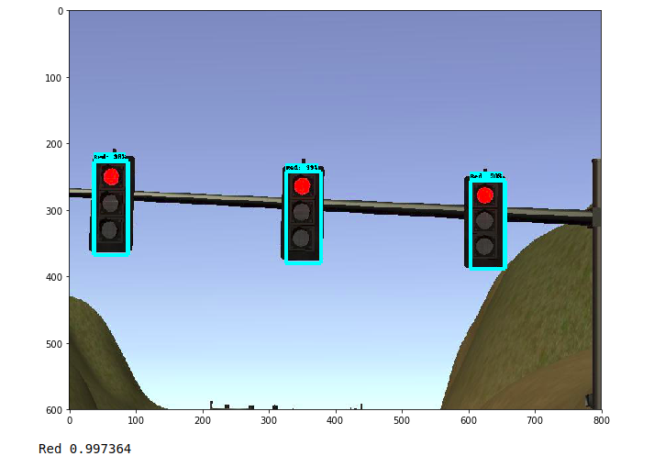
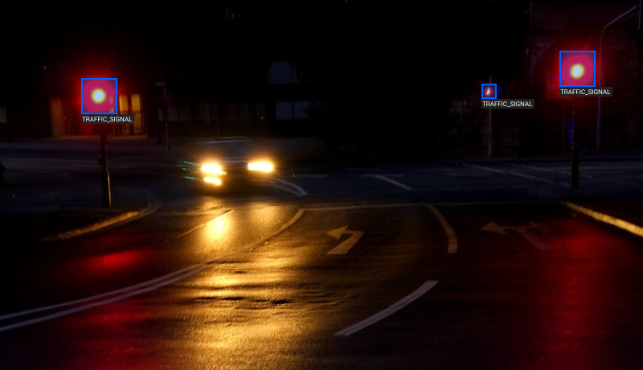
1.4 Traffic Light Detection
Not a simple problem:
Multiple shapes and lighting conditions are diverse.

Slide 8
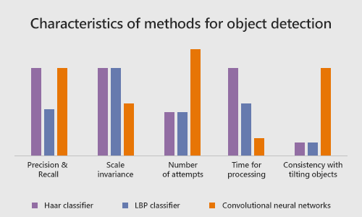
1.5 Limitations of HaarCascade
Haar Cascade performs well in many aspects including precision and time for processing.
Limitation in consistency with tilting objects.
Read recommended papers.
LBP: local binary patterns

Slide 9
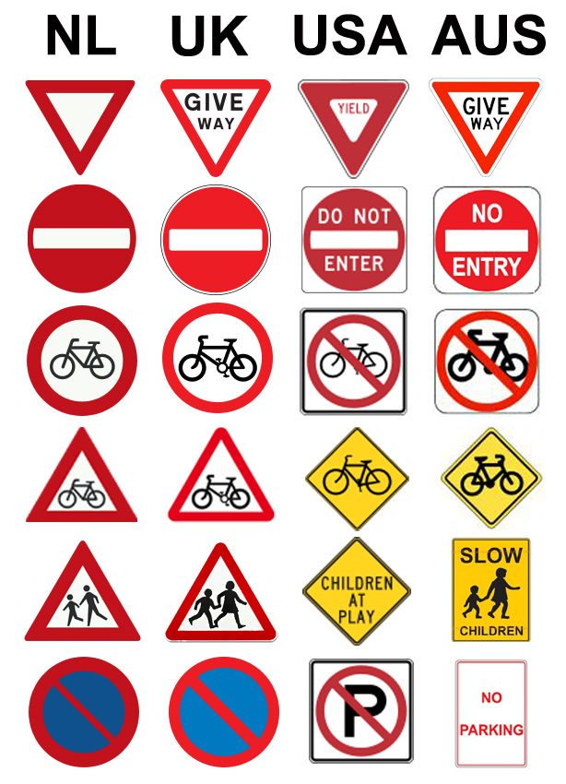
1.5 Other Limitations
Traffic Signs are country dependent
Even within English speaking countries, signs are different.

Slide 10
1.5 Optimization
Challenge:
Improve detection speed by resizing camera frames
ROI – focus region on the region of interest
Read less frames per second
Add logic – detect traffic on top half, cars on bottom half
Use gray image

